Slide 1


Allianz Support Fund
Building the best retirement plan with tax advantages
The attractive occupational pension for specialist and executive staff
Our General Tearms and Conditions for Insurance Contracts apply. Providing this information in English is a special service for you.All policy documents sent to you shall be in German. All communications on your policy relationship shall also be in German
© Allianz
© Allianz Lebensversicherungs-AG
Version:
January 2024

Slide 2
Product-
side

Slide 3

That‘s what the Allianz Support Fund offers
The ideal pension promise for high earners
The Support Fund is a government-incentivized form of occupational retirement provision. It is in particular suited for high earners who want to maintain their standard of living in retirement:
Premiums are tax-free without limitation and, in case of salary conversion, exempt from social security contributions up to 4 % of the contribution assessment ceiling stipulated for West German statutory pension insurance (CAC West). In case of employer-sponsored plans, the premiums are also exempt from social security contributions without limitation.
The benefit can be paid out in the form of a lifetime monthly pension or a non-recurring capital payment.

Slide 4
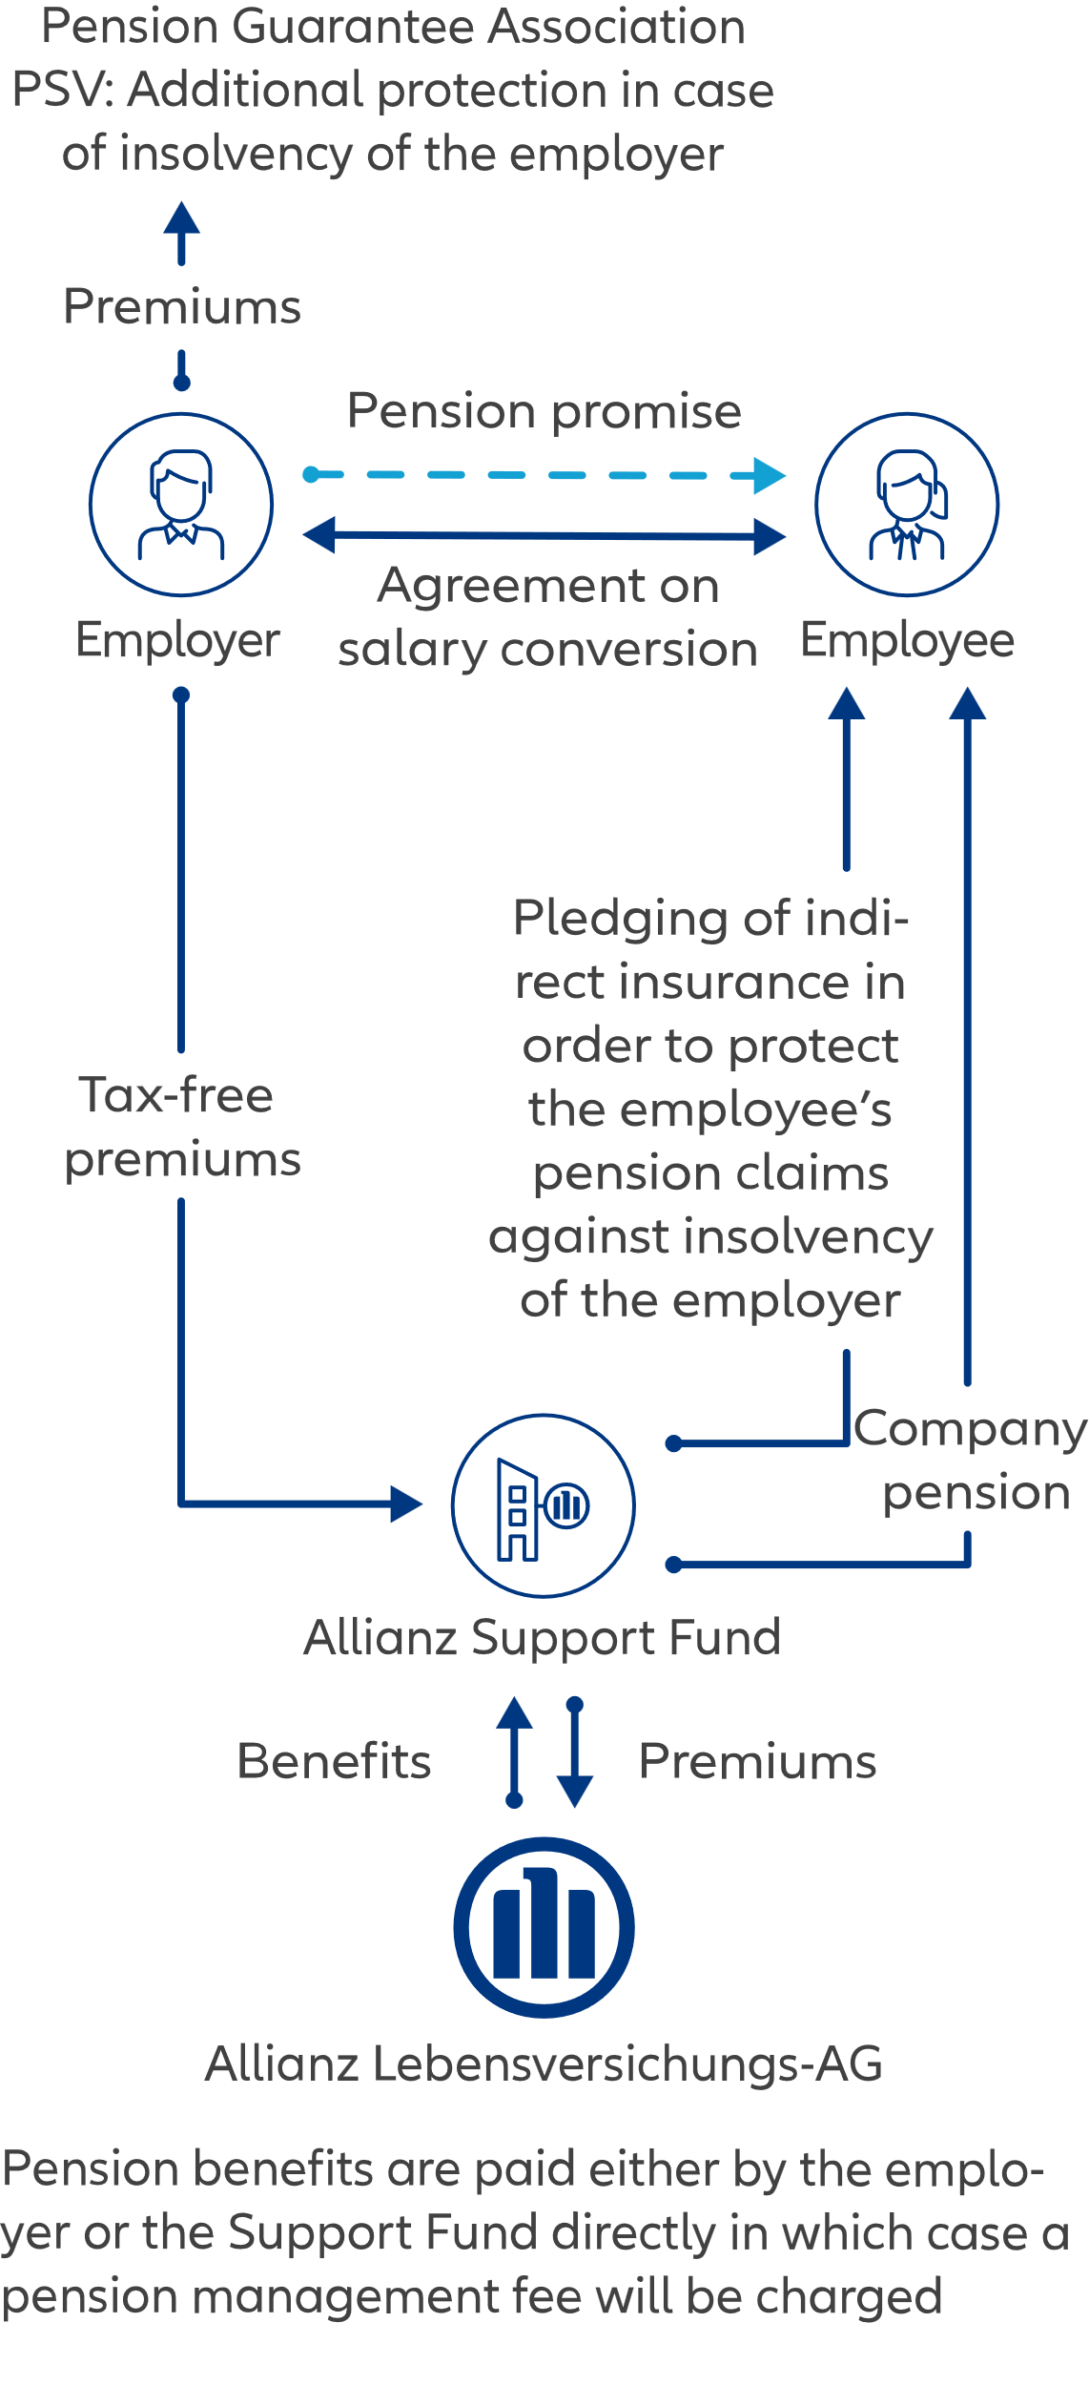
Funding methods
Two methods of funding the allianz support fund
The occupational retirement plan can be implemented in two ways:
Salary conversion scheme
Under a salary conversion scheme portions of untaxed gross salary will be invested in the retirement plan. In addition, the employer can make a contribution.
Employer-sponsored plan
Under this type of plan the premiums are exclusively funded by the employer.
Both methods can be combined.

Slide 5
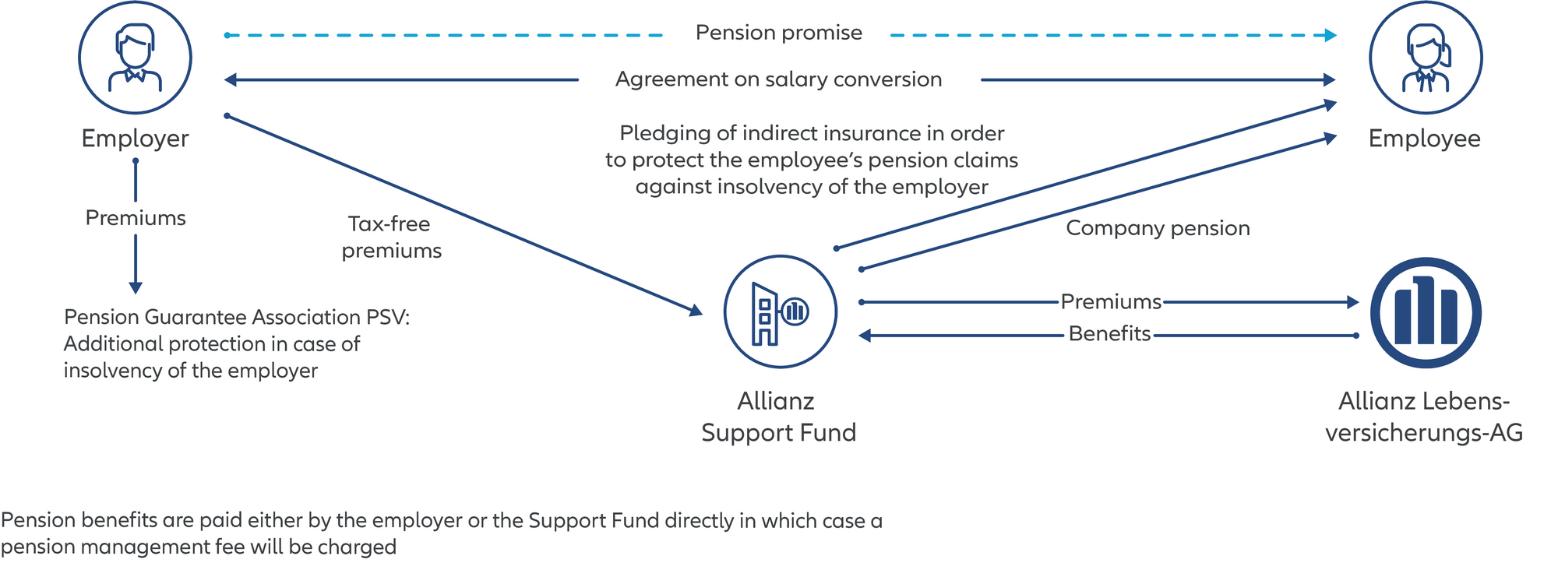
At a glance
That‘s how the Allianz Support Fund works

Slide 6


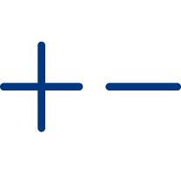




The advantages of the Allianz Support Fund
Advantages for employers
  Boosting employer attractiveness
  Higher employee loyalty and motivation especially among top performers. Providing an advantage in recruiting talent.
  Government sponsored
  Premiums¹ are tax-free without limitation and exempt from social security contributions up to 4% of the CAC West.²
  No balance sheet effect
  No balance sheet effects since pension risks are externalized.
  Flexible benefit payment
  Benefit payment can be made in the form of a capital or a lifetime pension.
  Efficient
  Lower administrative expense upon externalizing the administration to the Support Fund.
  Securing the standard of living
  Occupational pensions from a Support Fund are the best way to close higher pension gaps of higher-income earners.
  Individual
  Individual, industryspecific solutions.

Slide 7




Advantages for employees
These are the benefits of the Allianz Support Fund
  Government sponsored
  Premiums¹ are tax-free without limitation and exempt from social security contributions up to 4% of the CAC West.²
  Government sponsored
  Premiums¹ are tax-free without limitation and exempt from social security contributions up to 4% of the CAC West.²
  Flexible benefit payment
  Benefit payment can be made in the form of a capital or a lifetime pension.
  Flexible benefit payment
  Benefit payment can be made in the form of a capital or a lifetime pension.
  Securing the standard of living
  Occupational pensions from a Support Fund are the best way to close higher pension gaps of higher-income earners.
  Securing the standard of living
  Occupational pensions from a Support Fund are the best way to close higher pension gaps of higher-income earners.
  Enjoying security
  Pension claims are protected even upon insolvency of the company.
¹ Under employer-sponsored plans premiums are also exempt from social security contributions without limitation. ² Contribution assessment ceiling German statutory pension insurance contribution assessment ceiling (West). A salary conversion scheme can result in lower social security benefits and, if applicable to mandatory membership of statutory health and long-term care insurance. Retirement, disability and survivor‘s benefits have to be taxed as income from employment (§ 19 (1) sentence 2 Income Tax Act (EStG)).

Slide 8

Legal framework
Advantages for employees
Extensive legal protection and tax advantages
Premiums invested under a salary conversion scheme are tax-free without limitation and exempt from social security contributions up to 4 % of the CAC (West)¹. Under employer-sponsored plans premiums are both tax-free and exempt from social security contributions without limitation.
Benefits arising from a Support Fund are considered as subsequently earned pay.²
Occupational pension benefits are subject to statutory health and long-term care insurance contributions if the pensioner is a mandatory of voluntary member of statutory health insurance; a deduction applies to mandatory members of statutory health insurance.
The Support Fund can be concluded in addition to an occupational retirement plan in accordance with § 3 (63) EStG, e.g. direct insurance.

Slide 9
Important for employees and employers
Legal details
If a lump-sum benefit is paid out, it may be taxed according to the five-part ruling if the conditions are met.
The existing pension assets of a company pension plan have no influence on the determination and assessment of the entitlement to a citizen's pension (“Bürgergeld”).
In case of insolvency of the employer the Pension Guarantee Association (Pensions-Sicherungs-Verein a. G. (PSV)) will protect legally vested pension rights and pensions in payment (§§ 7 et seq. Company Pension Plans Act (BetrAVG)). The protection is funded by employer contributions. The contribution depends on the respective legal contribution assessment ceiling and the contribution rate. Alternatively, in the event of insolvency, it is possible to have the indirect insurance transferred to the employee and then continue this insurance privately.
The salary conversion scheme results in a reduced contribution assessment ceiling in the social security systems (old age, health, unemployment and accident insurance) and other social benefits, if applicable (e. g. parental allowance). This can result in correspondingly lower social security benefits.

Slide 10
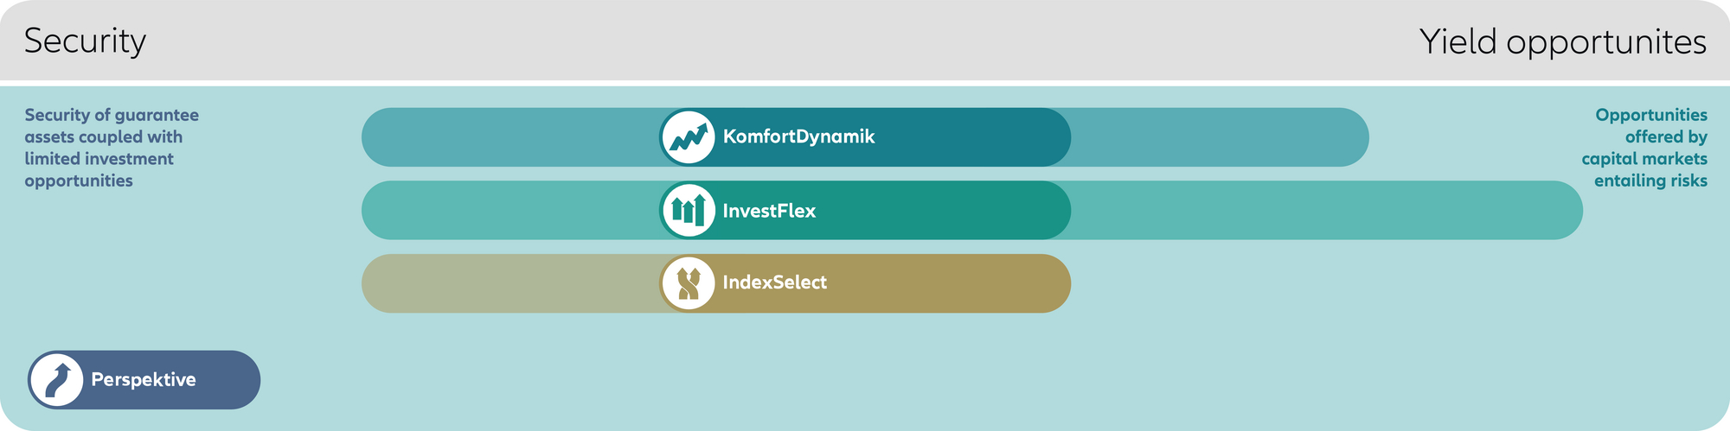
The Allianz pension concepts
The Allianz Support Fund – balance between yield opportunities and security
Our pension concepts meet various needs and wishes. The customers can individually define the balance between yield opportunities and securities and decide wether they want to fully entrust the Allianz experts with the investment or wether they want to have a say in the decision. Our customer can choose different pension concepts.

Slide 11




Modern guarantees open up scope for an attractive capital investment with Allianz Ukasse
The basis for good provision is strong security assets, combined with tailored pension concepts and modern guarantee levels.
Powerful stability component
The broadly diversified security assets as a stable basis for all pension solutions
Capital market opportunities at Allianz Leben
Modern, individual guarantee levels for a sustainable pension plan via the occupational pension scheme
Exemplary investment structure of Allianz Leben¹
KomfortDynamik
90 %²
80 %
60 %³
Shares
Emerging market government bonds
Infrastructure/renewable energies/private equity
Government bonds Industrialized countries
InvestFlex (Green)
253
Mrd.
Real estate
Mortgage bonds/collateralized loans
Corporate bonds
Real estate financing
Perspektive
90 %²
IndexSelect
Potential returns and security for more retirement provision
¹ Allianz Lebensversicherungs-AG, according to market values in percent, as at 30.09.2023.
² Guarantee level of 90 % for regular premiums only possible with St-tariffs.
³ With MetallRente, the guarantee level of 60 % cannot be selected.

Slide 12
Key data of the Support Fund at a glance
Easily explained
Tax-free premiums | Tax-free without limitation
Premiums exempt from social security contributions | Employer-sponsored: exempt from social security contributions / Salary conversion: exempt from social security contributions up to € 3,624¹ annually or € 301¹ monthly
Mode of payment | Premium must be level or increasing; No variable premiums
Type of investment | Choice between the pension concepts Perspektive, IndexSelect and KomfortDynamik. New: A pension commitment can also be concluded for all pension concepts.
Change of employer | Contract can be continued with new employer – however, no legal right / No continuation as private contract
Benefit payment | As of age 62 / Subject to taxation and social security contributions (applicable to members of statutory health and long-term care insurance)
Payment options | Pension, capital or a combination of both
Survivor’s provision and Income protection | Can be added
Minimum Age | 23 years, if a commitment is made for the first time after 2018²
Beiträge steuerfrei | Unbegrenzt steuerfrei | Unbegrenzt steuerfrei
Beiträge sozialversicherungsfrei | Bei Arbeitgeberfinanzierung: sozialversicherungsfrei. | Bei Entgeltumwandlung:
Zahlweise | Beitragshöhe frei wählbar Flexible Zahlweise, Zuzahlungen möglich | Unbegrenzt steuerfrei
Form der Anlage | Wählbar von sicherheits- bis chancenorientiert aus folgenden | Vertrag bei neuem Arbeitgeber fortsetzbar – jedoch ohne
Arbeitgeberwechsel | Vertrag bei neuem Arbeitgeber fortsetzbar – jedoch ohne | Vertrag bei neuem Arbeitgeber fortsetzbar – jedoch ohne
Auszahlung | Ab 62 Jahren möglich | Vertrag bei neuem Arbeitgeber fortsetzbar – jedoch ohne
Auszahlungsoptionen | Als Rente, Kapital oder Kombination | Vertrag bei neuem Arbeitgeber
Mögliche Ergänzungen | Hinterbliebenenvorsorge und/oder Einkommensvorsorge | Unbegrenzt steuerfrei
Beiträge steuerfrei | Unbegrenzt steuerfrei | Unbegrenzt steuerfrei | Unbegrenzt steuerfrei
Beiträge sozialversicherungsfrei | Bei Arbeitgeberfinanzierung: sozialversicherungsfrei. | Bei Entgeltumwandlung: | Bei Entgeltumwandlung:
Zahlweise | Beitragshöhe frei wählbar Flexible Zahlweise, Zuzahlungen möglich | Unbegrenzt steuerfrei | Unbegrenzt steuerfrei
Form der Anlage | Wählbar von sicherheits- bis chancenorientiert aus folgenden | Vertrag bei neuem Arbeitgeber fortsetzbar – jedoch ohne | Vertrag bei neuem Arbeitgeber fortsetzbar – jedoch ohne
Arbeitgeberwechsel | Vertrag bei neuem Arbeitgeber fortsetzbar – jedoch ohne | Vertrag bei neuem Arbeitgeber fortsetzbar – jedoch ohne | Vertrag bei neuem Arbeitgeber fortsetzbar – jedoch ohne
Auszahlung | Ab 62 Jahren möglich | Vertrag bei neuem Arbeitgeber fortsetzbar – jedoch ohne | Vertrag bei neuem Arbeitgeber fortsetzbar – jedoch ohne
Auszahlungsoptionen | Als Rente, Kapital oder Kombination | Vertrag bei neuem Arbeitgeber | Vertrag bei neuem Arbeitgeber
Mögliche Ergänzungen | Hinterbliebenenvorsorge und/oder Einkommensvorsorge | Unbegrenzt steuerfrei | Unbegrenzt steuerfrei

Slide 13
Capital payment: Five-part ruling as example for severance pay
Sample calculation for the Support Fund
An employee has a taxable income of € 42,000 and receives a one-time lump-sum payment (from severance pay¹ or support fund/pension promise) of € 100,000. The severance pay¹ amounts to € 100,000 (= extraordinary income within the meaning of section 34 EStG).
Alternative | Without five-part ruling |  | With five-part ruling
Tax² | Amount | Income tax | Amount | Income tax
(1) taxable income "normal" | € 142,000 | € 38,434 | € 42,000 | € 4,022
(2) one fifth of the extraordinary income |  |  | € 20,000
(3) taxable income "splitting table" |  |  | € 62,000 | € 9,468
(4) difference Income tax (3) ./. (1) |  |  |  | € 5,446
(5) Tax on severance pay= 5* difference Income tax (4) |  |  |  | € 27,230
Total income tax (income tax (1) + (5)) |  | € 38,434 |  | € 31,252
Total tax incl. Church tax 8% and solidarity surcharge |  | € 41,767 |  | € 33,752
Advantage of five-part ruling |  |  |  | € 8,015
¹ after deduction of the pension allowance, the supplement to the pension allowance and the corresponding lump sum for income-related expenses
² Income tax rate 2024, splitting table, church tax 8 %. Calculations are based on tax and social security legislation applicable in 2024.

Slide 14
Appropriate additional modules increase employee loyalty
Support Fund – combinations
The Allianz Support Fund offers the employer the possibility to grant an extensive benefit promise – on a defined contribution basis:
Support Fund
Retirement provision
Optional for the insured in the form of:
Capital payment
Lifetime pension
Disability provision optional as:
Waiver of premium upon disability
Disability pension
Survivor‘s provision
Lump sum on death
Survivors' pension
Support Fund
Retirement provision
Disability
Survivor‘s provision

Slide 15
Pension concepts & additional modules –
Innovations as of 01/2024
Support Fund
 | KomfortDynamik | Perspektive | IndexSelect | New: InvestFlex at APM | Chance (InvestFlex) at Metall/KlinikRente
Garantee level | 60%, 80% or 90%** | min. 90 %** | min. 90 %** | 60%, 80% or 90%** | (60%***), 80% oder 90%
Capital commitment with pension option* | Yes | Yes | Yes | Yes | Yes
Pension commitment with capital option* | Yes | Yes | Yes | Yes | Yes
Inclusion disability module | Yes | Yes | Yes | Yes | Yes
Inclusion of a survivor's pension for pension commitments | Yes | Yes | Yes | Yes | No
Inclusion of a lump-sum death benefit (module C) for capital commitments | Yes | Yes | No | Yes | No
* Due to the system, a lump-sum commitment leads to comparatively higher PSV contributions in the vesting phase. In contrast to a pension commitment, however, the obligation to make contributions in a benefit phase does not apply to a lump-sum commitment. All PSV contributions can be claimed as business expenses for tax purposes.
^{** 90% only for St/Sn-tariffs.}
*** A guarantee level of 60% is also possible with KlinikRente Chance.

Slide 16

Disability module in occupational retirement plans: “Pension saver“ upon onset of disability
Support Fund – combinations
Advantages for employees
Reliable protection of the occupational retirement plan against the consequences of disability including government incentive
Waiver of premium already as of 50% disability
Acceptance based on simplified risk examination (at-work statement)
No abstract referral to other occupations
Special terms via the employer
„ The company pension is safe!“

Slide 17

Disability pension module in occupational retirement plans: “Income and pension saver“
Support Fund – combinations
Advantages for employees
Reliable protection against the consequences of disability including government incentive
Waiver of premium and disability pension already as of 50% disability
If applicable, simplified risk examination
No abstract referral to other occupations
The Support Fund does not provide for private continuation of the contract
Top marks for disability provision
Special terms via the employer
„ The current standard of living and also retirement can be secured“!

Slide 18
Compatibility with other pension vehicles
Flexibility with the Support Fund
In order to close a larger pension gap several occupational pension vehicles can be combined, e.g. Support Fund with direct insurance and pension promise.
Net salary
FlexiVorsorge
Pension promise
Tip: All three pension vehicles provide for extensive risk protection consisting of income and/or survivor‘s provision.
TopVorsorge
Support Fund
Pension gap
BasisVorsorge
Direct insurance
Statutory pension arising from German statutory pension insurance

Slide 19
Differences between the Support Fund and other occupational pension vehicles
Support Fund compared to other pension vehicles
 | DI | P-Fonds² | S-Fund | PP
Tax advantage | Premiums up to 8 % of the CAC (West) are tax-free¹ | Premiums up to 8 % of the CAC (West) are tax-free¹ | Premiums tax-free without limitation | Premiums tax-free without limitation
Social security | § 3 (63) EStG: exempt up to 4 % of the CAC (West) | § 3 (63) EStG: exempt up to 4 % of the CAC (West)¹ | ER-sponsored: exempt, EE-funded: exempt up to 4 % of the CAC West, in addition to § 3 (63) EStG | ER-sponsored: exempt, EE-funded: exempt up to 4 % of the CAC West, in addition to § 3 (63) EStG
Premium payments | Ongoing, abridged or variable premium payment and single premium | Ongoing (variable) premium payment and single premium | Matching life insurance; For entitled EEs: ongoing, level or increasing premium payment, for pensioners: single premium | Internally by book reserves (§ 6 a EStG) and indirect insurance with ongoing, abridged or variable premium payment and single premium
Tax incentives | § 3 (63) EStG and Riester | § 3 Nr. 63 EStG and Riester | - | -
Continuation upon change of employer | For new promises as of 01.01.2005 | For new promises as of 01.01.2005 | No right, transfer on a voluntary basis | No right, transfer on a voluntary basis
Private continuation | Possible | Possible | Not possible. Only private continuation of the indirect insurance policy is possible in the event of insolvency according to the offer of the PSVaG. | Not possible. Only private continuation of the reinsurance policy is possible in the case of BilMoG commitments in the event of insolvency, possibly after an offer from the PSVaG
Pension concepts | Perspektive, KomfortDynamik, IndexSelect, InvestFlex | – | Perspektive, KomfortDynamik, IndexSelect and InvestFlex³ | Perspektive, KomfortDynamik, IndexSelect, InvestFlex
¹In accordance with § 3 (63) EStG, ² Pensionsfonds in accordance with § 3. Nr. 63 EStG is closed to new business

Slide 20


Occupational retirement plan management with FirmenOnline
Tools
The FirmenOnline occupational pension portal considerably simplifies the occupational pension management in the company. Two portals are available:
Employer portal
Employers can easily and efficiently manage all occupational pension contracts online – with full transparency regarding all activities and processes.
Employee portal
Employees have online access to all information regarding the company‘s occupational pension offer in a clearly arranged manner – with explainer videos and helpful calculation tools.
Direct access to firmenonline.de

Slide 21
Taxation of benefits
Questions regarding the Support Fund
Are retirement benefits taxed?
  Yes. The Support Fund pension will be taxed as subsequent pay, however, usually at a lower tax rate than in working life. In case of capital payments your tax burden can be reduced by the “five-part ruling“. In addition, the maturity capital will usually be paid in the following year. Members of statutory health insurance also have to pay statutory health and long-term care insurance contributions.

Slide 22
Effect on the statutory social security systems
Questions regarding the Support Fund
What effect does a salary conversion scheme have on the statutory social security systems?
  The salary conversion scheme results in a reduction of gross salary. As a result, contributions to the social systems can be lower. Therefore, the statutory unemployment, health, pension or long-term care insurance benefits can decrease. However, in many cases the difference is only a few euros.
  If gross income falls below the limit of € 69,300 (compulsory insurance limit stipulated for health and long-term care insurance, as of 2024), salary conversion can also result in the obligation to resume membership of statutory health insurance instead of private health insurance.

Slide 23
Leaving service
Questions regarding the Support Fund
What happens with the Support Fund contract upon leaving service?
  The Allianz Support Fund can be continued with the new employer if the new employer agrees and is or becomes a member of the same pension provider. Otherwise, the retirement plan will remain paid-up until the benefit is claimed.
  The Support Fund cannot be continued as private contract.

Slide 24
Insolvency of the employer
Questions regarding the Support Fund
Is the occupational pension protected if the company becomes insolvent?
  Even if the employer were to become insolvent, the occupational pension of employees who come under the scope of the Company Pension Plans Act (BetrAVG) is protected via the Pension Guarantee Association (Pensions-Sicherungs-Verein PSV).¹ Entitled employees who do not come under the scope of the BetrAVG (e. g. controlling managing directors-shareholders) are also sufficiently protected against the employer‘s insolvency through the statutes or by additional pledging. Alternatively, in the event of insolvency, it is possible to have the indirect insurance transferred to the employee and then continue this insurance privately.

Slide 25
Insolvency protection by PSV
Questions regarding the Support Fund
Years | Promille set | PSV annual contribution (with a monthly contribution of € 105,81) This corresponds to the following promised benefit: RSKU1U = € 1,200 annual pension/ € 39.484,49 guarantee capital PSV for pension commitment RS2U / lump-sum commitment RSKU1U
2019 | 3,1 | 18,60 EUR / 61,20 EUR
2020 | 4,2 | 25,20 EUR / 82,92 EUR
2021 | 0,6 | 3,60 EUR / 11,85 EUR
2022 | 1,8 | 10,80 EUR / 35,54 EUR
2023 | 1,9 | 11,40 EUR / 37,51 EUR
For legally vested rights and current benefits
Minimum age must be met
Maximum limits
For salary conversion in the first 2 years up to 4% of the contribution assessment ceiling stipulated for West German statutory pension insurance
Pledge of the indirect insurance policy
Assessment ceiling:
Pension commitment: Sum of annual (legally vested) pension benefits times 25 % times 20
Capital commitment: 10% of the (statutory vested) pension benefit times 25% times 20
Alternatively, in the event of insolvency, it is possible to have the indirect insurance transferred to the employee and then continue this insurance privately.

Slide 26
Financial shortage
Questions regarding the Support Fund
What happens if premium payment is to be reduced?
  For tax reasons the Support Fund must be funded by ongoing level (or increasing) premiums.
  Premium payment can be reduced or suspended under certain conditions without constituting a violation of the tax rules. However, a reduction of premiums must not be intended from the outset.

Slide 27
Benefits in the event of death
Questions regarding the Support Fund
What happens in the event of death?
  In the event of death of the employee during the accrual phase the survivors are protected by a capital payment or a pension – depending on the type of Support Fund and the premium rate agreed: Spouses and registered partners as well as children, if they are entiteled to child allowance, until age 25. In addition, a companion designated by name can be a survivor (marriage-like partnership).
  Depending on the premium rate survivors will receive a benefit in the event of death also during the pension payout phase.

Slide 28
Customer
side

Slide 29

In what cases is the Support Fund an ideal tool for employers?
Fact-checking
I want to motivate my employees and retain top performers.
I want to boost the attractiveness of my company for highly qualified job candidates.
I want to provide older employees with the possibility to build up retirement provision in a short time.
I want to support employees who have already exploited the funding limit.

Slide 30

In what cases is the Support Fund an ideal tool for employees?
Fact-checking
I want an occupational pension that allows me to maintain my usual standard of living in retirement.
As employee or manager I earn good money and wish to additionally build up a larger financial cushion.
I have already exploited the tax-free limits of other retirement plans (e.g. direct insurance, Pensionskasse or pension fund).

Slide 31
For what type of employers is the Allianz Support Fund suitable?
Aid in the decision-making process
Suitable ...
in order to retain experienced specialist and executive staff that is hard to replace.
for companies aiming at avoiding balance sheet effects.¹
Less suitable ...
for medium-sized handicraft businesses.
for freelancers.
¹ E.g. companies with a foreign parent company.

Slide 32
For what type of employees is the Allianz Support Fund suitable?
Aid in the decision-making process
Suitable ...
for employees in higher salary brackets.
if the tax-free limits of direct insurance, Pensionskasse or pension fund have been exploited.
for older employees for whom retirement provision should be built up in a short time.
Less suitable ...
if flexible premium payment or a possible reduction of premiums is requested.
for employees who want to claim their retirement benefits before completion of age 62.
for self-employed and freelancers.

Slide 33

Model calculation
Allianz Support Fund in figures
Gross premium: | 100 €
Tax savings: | – 30 €
Insurance premiums are directly deducted from gross salary and are therefore tax-free.
Social security savings: | – 20 €
The second advantage is that no social security contributions have to be paid.
Actual expense: | 50 €
The government chips in with approx. € 50 in premiums. In order to invest € 100 monthly only half of the amount has to be paid out of pocket.

Slide 34
Market
side

Slide 35
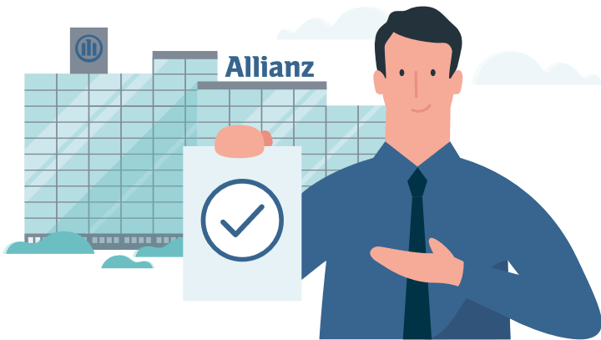
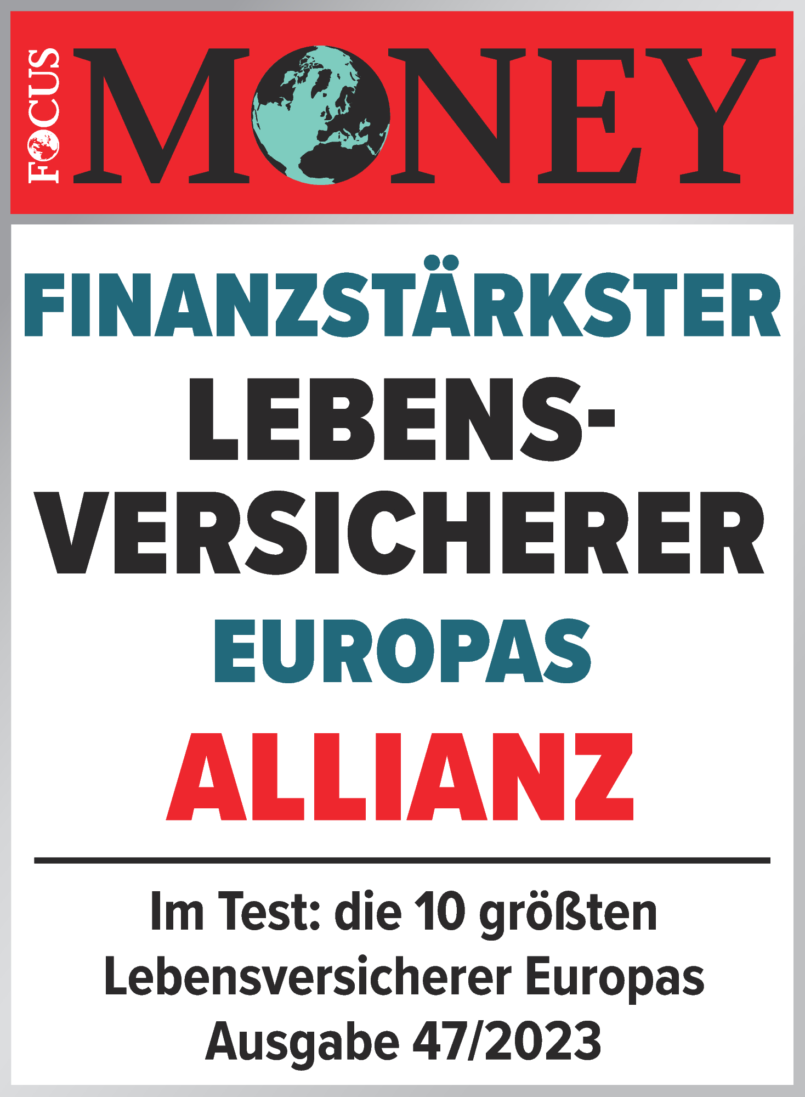

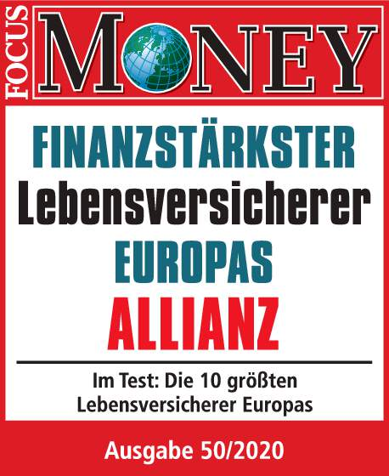
Arguments in our favor
Strong partnership
Sustainability based on innovative products: We provide an attractive balance between yield opportunities and security with individual weighting even in times of zero and negative interest rates.
Stability thanks to a strong basis: Our guarantee assets are the basis for reliable retirement provision. They provide stability – even in turbulent times.
Investment expertise with a vision: Our investments are worldwide, broadly diversified and sustainable. Our size and our experience allow us to provide unique investment solutions.
FOCUS-MONEY:
Award: “Financially strongest life insurer in Europe“, edition 47/2023
FOCUS-MONEY:
Auszeichnung „Finanzstärkster Lebensversicherer Europas“, Ausgabe 50/2020

Slide 36
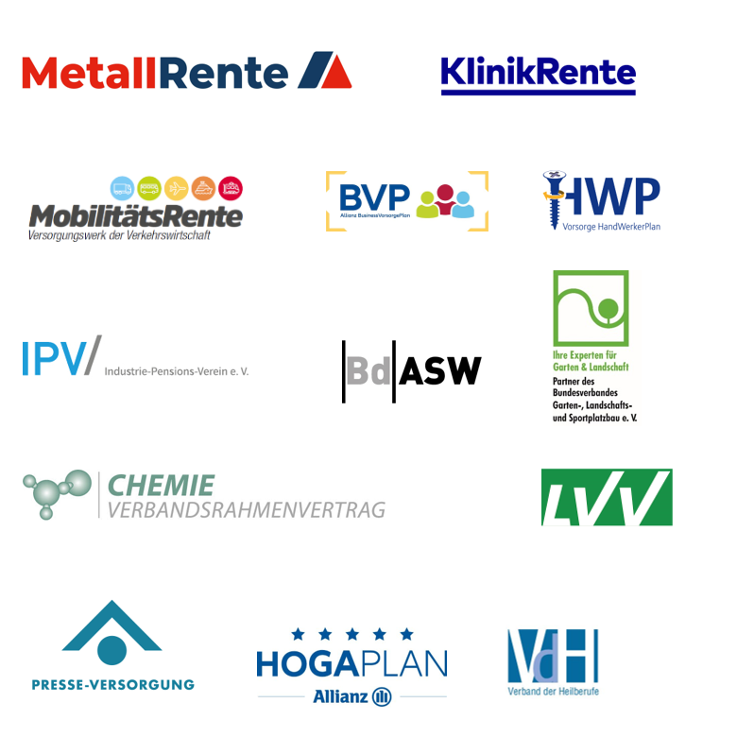
Allianz Leben is the number 1 in occupational retirement plans
Our competitive position
Trust …
More than 80 of the 100 of the largest companies in Germany put their trust in us
20 percent of all German companies
We are the partner …
to various collective and consortium agreements, e.g. consortium agreement with the chemical industry
to pension schemes such as MetallRente, Presse-Versorgungswerk, KlinikRente, MobilitätsRente, Business Vorsorge Plan, HandWerkerPlan, GalaBau
The occupational pension solutions of Allianz offer:
Absence of liability on the employer‘s side
All-in offer: 4 pension vehicle, working time accounts and supplementary disability provision

Slide 37



The basis of our sustainable actions since 2012 – Our ESG strategy
Leading company in Europe
For us, sustainable action means long-term economic value creation combined with a forward-looking ESG concept for ecological self-commitment (E), social responsibility (S) and good corporate governance (G).
  E like Environmental:
  Ecological self-commitment
Allianz actively contributes to positive advancement and transformation by specific global investments in sustainability projects
Evaluation of investments and sites with respect to carbon emissions, e.g. Allianz has reduced the carbon emission per employee by over 40% since 2006
Definition of clear objectives in order to limit global warming to 1.5°C within the scope of the AOA¹
  S like Social:
  Social responsibility
Human rights and fair working conditions are observed
Allianz has entered into partnerships with SOS children‘s villages
Charitable commitment, e.g. Allianz Children’s Foundation
Support for EqualPay and EqualPension
  G like Governance:
  Good corporate governance
Consideration of ecological and social aspects in the core business activities
Trust develops through applied transparency
Combating in-house corruption
Ensuring data protection and data security

Slide 38
Legal Disclaimer
We expressly point out that statements referring to competitors of Allianz Leben are gathered from press articles, annual reports and model calculations made by third parties. We cannot be held liable for any errors or misrepresentations contained therein.
The contents of this presentation are the intellectual property of Allianz Deutschland AG. Any further use and transmission to third parties in the form of the original document, copy or extracts, in electronic form or presentation.

